Slide 1
Intro – Programming in R and Python
Jan van Grimbergen, Jonathan Bobak
18.11.2024

Slide 2


Computers are inherently dumb
Expectation
Reality

Slide 3

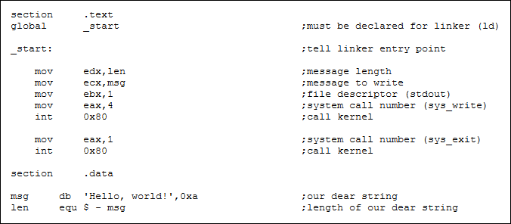



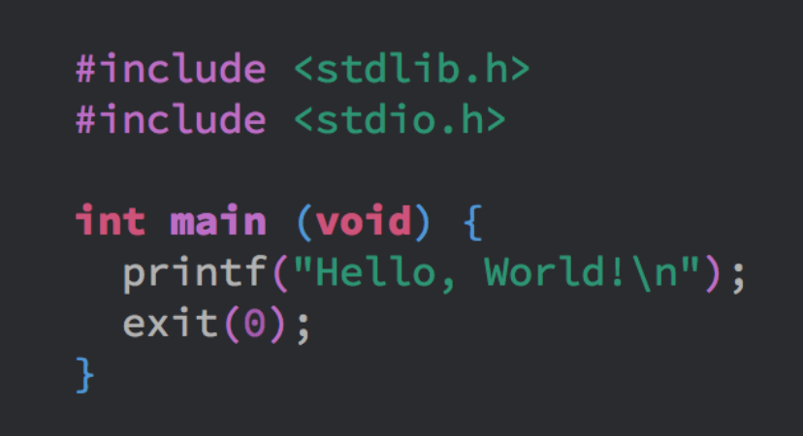


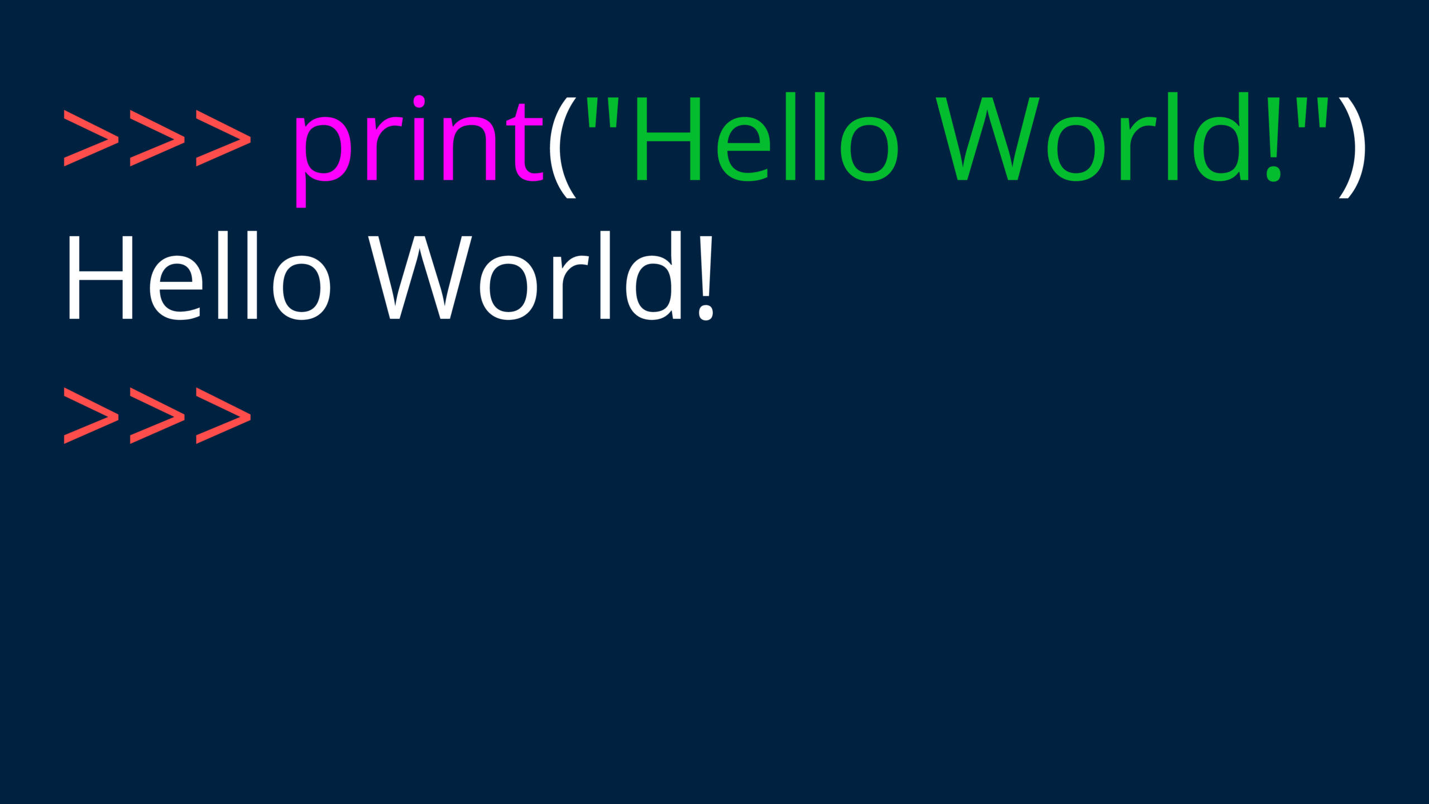

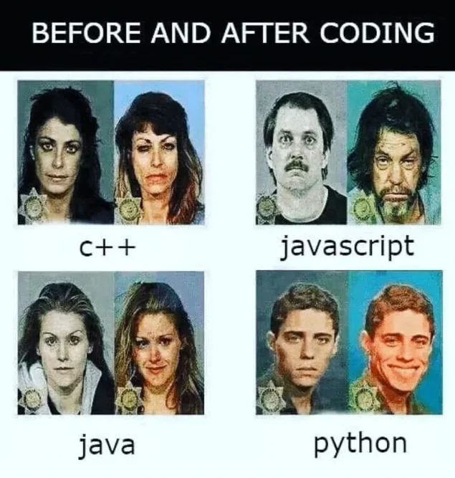
From language to 0s and 1s
Machine
language
Human
language
Suffering
Enjoyment

Slide 4

GitHub Repo
All notebooks and exercises from today
R and python
including datasets
learning_ressources.md
tutorials, cheat sheets and tools for programming
for both R and python
If you find a resource online helpful
contribute and share it here
(GitHub Account required)

Slide 5
Basics
Each programming language has a syntax
Like human language
Very simple vocabulary
Defined grammar (e.g. subject predicate object)
Basic building blocks
Keywords (if, else, while, …)
Identifiers (variable & function names)
Comments (ignored by computer, just for us)

Slide 6
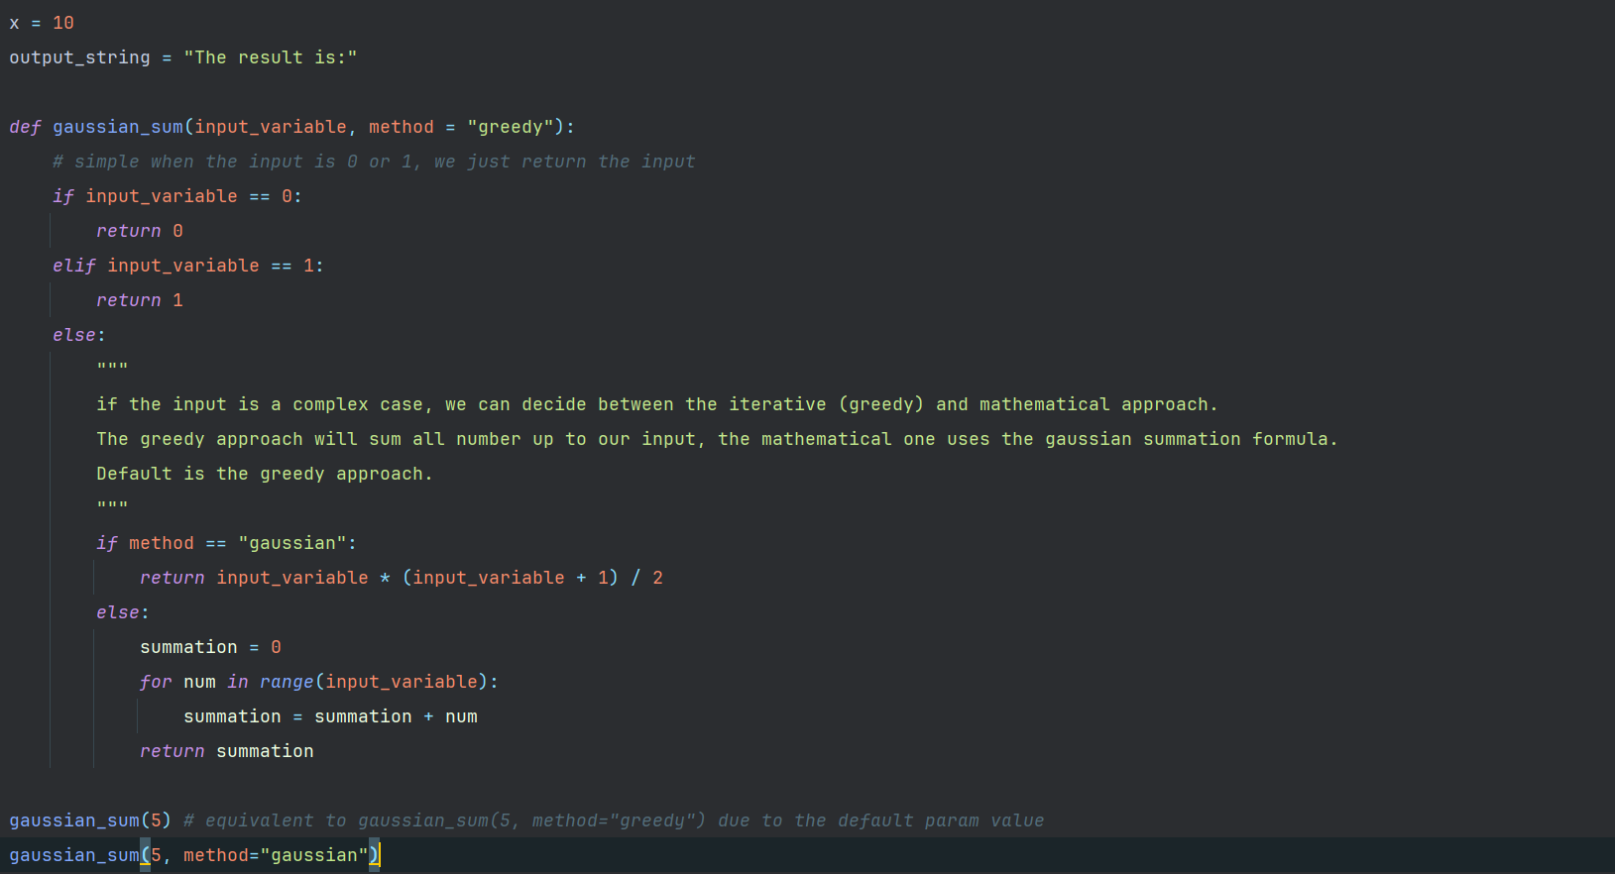
Assignment operations
The result is:
output_string
50
Identifiers: variable names helping us track their content
Values → simple datatypes
numeric
string
boolean
10
x
85
12
77
56

Slide 7


function definition
function name
: signalizes end of header
The result is:
output_string
50
10
def keyword to signalize start of function
A function always starts with a header
function parameters in () brackets
method = „greedy“ sets a default value
input_variable
x
85
$$f$$
function call: gaussian_sum(x)
gaussian_sum
12
greedy
method_default
77
input
output
56

Slide 8
function body
: signalizes end of header
The body is always indented by one tab
function starts with a comment

Slide 9
if-statement definition
condition of if-statement
: signalizes end of header
keyword for if statement

Slide 10
if-statement body
statement body
return keyword
exit function
return the value 0
The body is always indented by one tab

Slide 11
elif-statement definition
condition of elif-statement
: signalizes end of header
keyword for else if
requires a new condition

Slide 12
elif-statement body
statement body
return keyword
exit function
return the value 1
The body is always indented by one tab

Slide 13
else-statement definition
: signalizes end of header
keyword for else
no new condition

Slide 14
else-statement body
statement body
multiline comment
still needs to be properly indented
The body is always indented by one tab

Slide 15
nested if
condition of if-statement
: signalizes end of header
keyword for if
is nested inside the else branch

Slide 16
nested if
statement body
return keyword
exit function
return the result of computation
The body is always indented by one tab.
Since this statement is nested and inside a function → 3 tabs

Slide 17
computations
mathematical formula
uses one of the function parameters as a variable
standard order of operations applies
brackets can change order of operations

Slide 18
nested if
: signalizes end of header
keyword for else
due to indentation it is connected to the nested-if

Slide 19
nested if
The body is always indented by one tab.
Since this statement is nested and inside a function → 3 tabs
statement body

Slide 20
for-loop
keyword for loop
keyword for specifying which list the iteration variable is refering to
: signalizes end of header
range(n) is a built-in function to generate a list with entries [0, 1, 2, …, n-1]
iteration variable

Slide 21
for-loop
we are
inside a function (1 indent)
inside this else branch (1 indent)
inside this else branch (1 indent)
inside the for loop (1 indent)
→ 4 tab indents total
4 tab indents

Slide 22
for-loop
assignment operation
adding two variables of numerical type

Slide 23
for-loop
3 indents = we left the for loop
return keyword
exit function gaussian_sum
return the value of summation variable

Slide 24
function calls
function call with a single parameter
„method“ has a default value and can be omitted
inline comment (# symbol)
will be ignored by the computer
no indents = we left the function

Slide 25
function calls
function call with a two parameters
„method“ has a default value but since we specify it, it will be overwritten

